Slide 1


PROJECT EXHIBITON 2
FINAL REVIEW

Slide 2
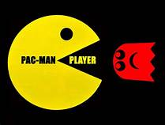

PROJECT GUIDE : DR. HARIHARA SITARAMAN
TEAM MEMBERS
Anshuman Singh 19BCE10380
Gaurang Sharma 19BCE10001
Shivam Gupta 19BCE10321
Watan Singh Prajapati 19BCE10229

Slide 3
INTRODUCTION
As we all use internet and do surfing a lot but when the network breaks down, then we just feel bored. So our project ARCADE is all about it. As the network breaks the chrome browser gives us game to play where we can pass time. So, in our project we are going to build upto 5-6 flash games ,which will make the waiting more interesting.
So, our project is all about this specific part, making some 5 to 6 flash games which if users play then it will surely entertain them.

Slide 4
EXISTING WORK WITH LIMITATIONS
When we are offline the chrome browser provide only one boring game to play and which is in black and white, which eventually makes the user to lose interest after 1-2 turns. So we are trying to overcome this problem

Slide 5
PROPOSED WORK
We are giving a solution to the problem of dull game of T-Rex jump. So, our project is all about making some 5 to 6 flash games which if users play then it will surely entertain them.

Slide 6
NOVELTY OF THE PROJECT
The browsers like Chrome provides dull and lifeless game like T-rex, which the users don’t even play. We want to make the offline experience better for our user. We provide a combination interesting and enthralling games like pac-man and candy crush which are very trendy and captive.

Slide 7
REAL TIME USAGE
Games for Health aim to improve players’ health, usually through education, development of new habits, or the execution of healthy tasks; Exergames are used as forms of physical or mental exercise; Simulation Games are used to exercise or acquire different skills through the simulated execution of real world tasks; and Games for Change or Games with a Purpose try to solve various tasks related to the wellbeing of society, such as concerns related to equality, the environment, or health care.Some examples of serious games are Minecraft Edu, a customization of the popular sandbox game Minecraft used in schools for teaching purposes, and FoldIt, a game that enables anyone to contribute to scientific research on protein folding

Slide 8
HARDWARE AND SOFTWARE REQUIREMENTS
HARDWRE RRQUIREMEMTS:
1.Desktop or laptop
2. Processor : 2.3 ghz
3. Memory : 2 GB RAM
4. Graphics : Intel HD Graphics
5. Storage : 1500 MB available space
Software(Minimum)
1. Windows 7,8(64 bit) or Mac
2.Web-Browser

Slide 9
OVERALL SYSTEM ARCHITECTURE DIAGRAM
PLANING
FRONT END
BUILDING GAMES
MERGING ALL UNDER ONE WEB-PAGE

Slide 10
LITERAURE REVIEW
Browser technology quickly began to mature in the mid-1990s with support for browser plug-ins and the introduction of JavaScript. More advanced browser interactions, unbounded by the restrictions of HTML and that used client-side processing were possible.
Flash games were considered to have hit their peak in the mid-2000s but waned by the early 2010s.
However, the latter part of the 2000s in terms of browser games also overlapped with the emergence of indie games. In the late 1990s and early 2000s, the video game industry had started to coalesce around triple-A development, games made by large studios with multi-million dollar budgets
Post-2010, browser games written in other formats besides Flash remain popular, such as HTML5, WebGL, and WebAssembly.[ The .io domain, which was first used in 2015 by Agar.io, has become a popular domain attached to browser games

Slide 11
MODULE DESCRIPTION
PLANING: The project is a complex and there are many technologies involved. So, we are first slipping the project into many parts.
FRONT END: There will be a HOME page where we can access all the games. This will be an alluring page where all the games will be compiled.
BUILDING GAMES: The project involves five to six flash games that are attractive as well as agglutinate to the computer screen.
MERGING ALL UNDER ONE WEB-PAGE: We will merge all the games in a HOME page. The HOME page will contain all the images of the game and will be displayed accordingly.

Slide 12
MODULE WORK FLOW EXPLANATION
We started the project by wire framing the web-page. Then we started to make the games. First we made the pacman game and then the candy crush replica and then we completed the 2048 and the snake game. Then we complied all the games under a single web-page which is our home page. Then we beautified the entire project with css.

Slide 13
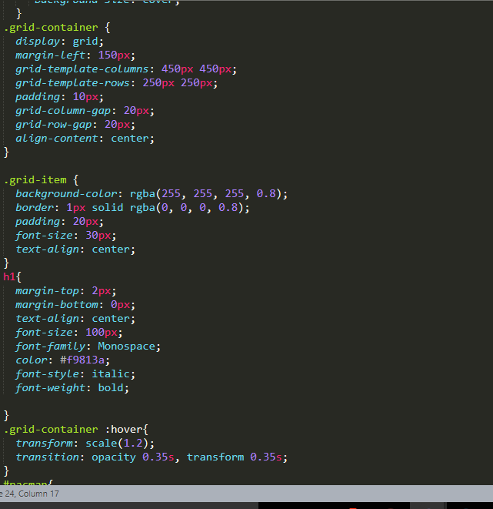
IMPLEMENTATION AND CODING

Slide 14
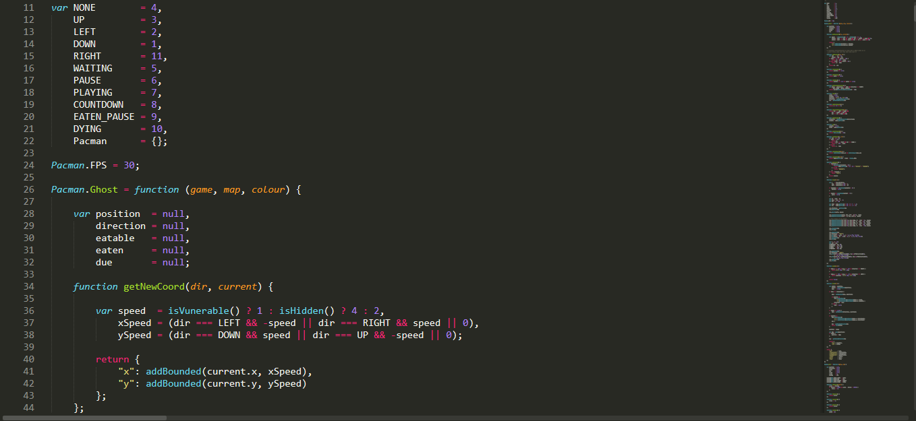

Slide 15
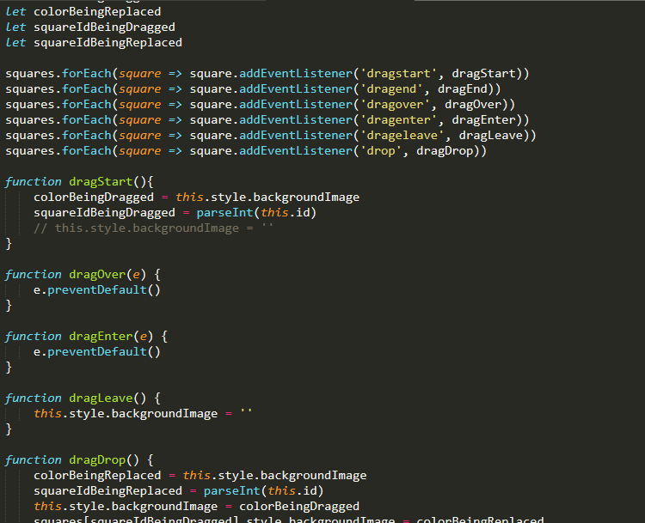

Slide 16
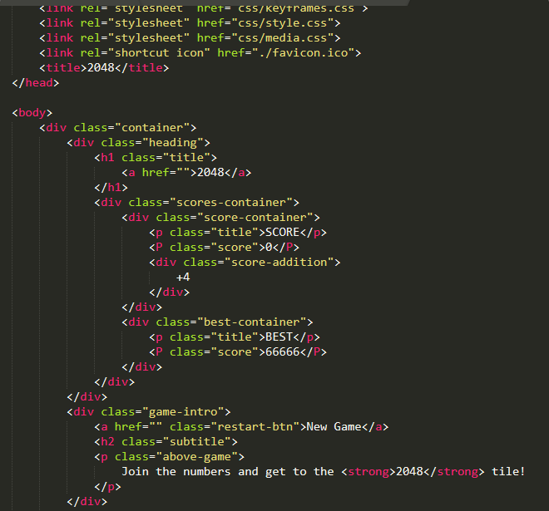

Slide 17
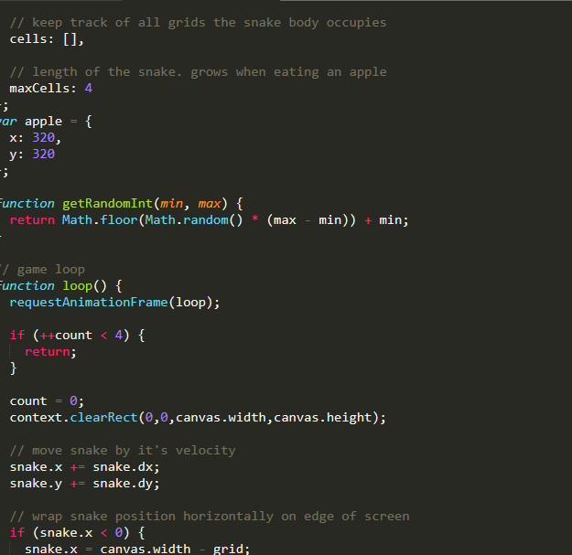

Slide 18
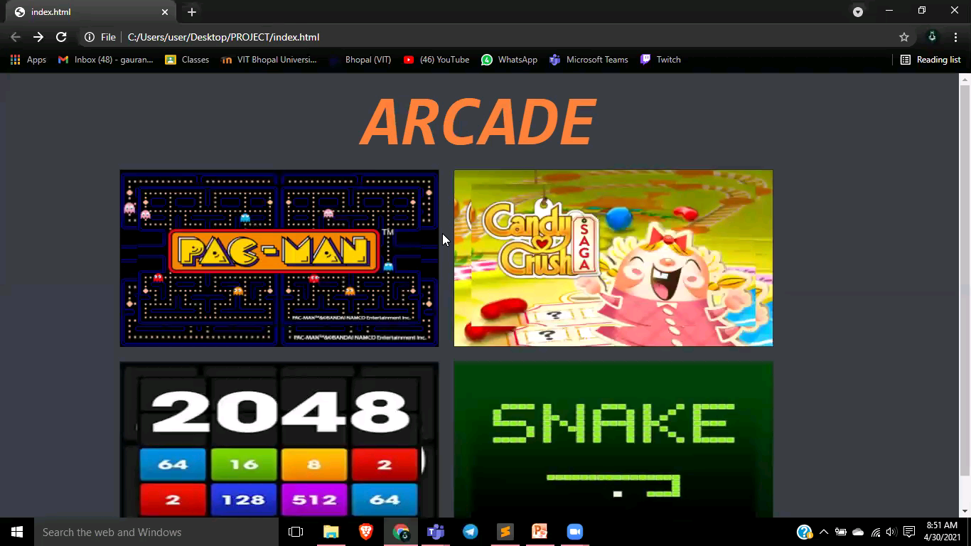
DEMO VIDEO

Slide 19
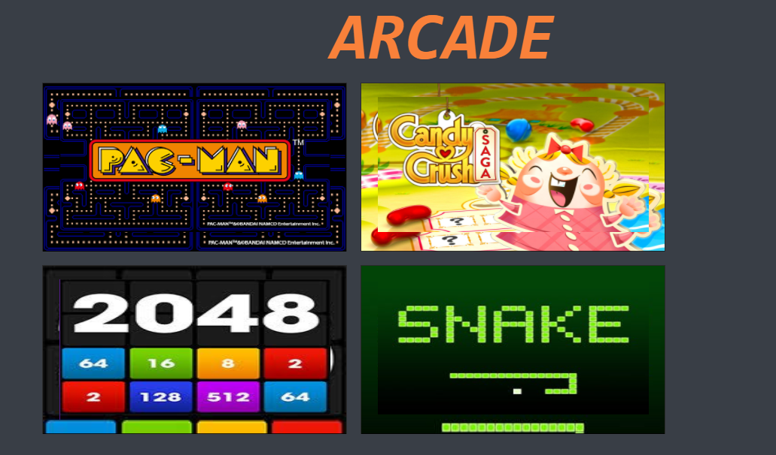
SNAPSHOT OF THE PROJECT

Slide 20
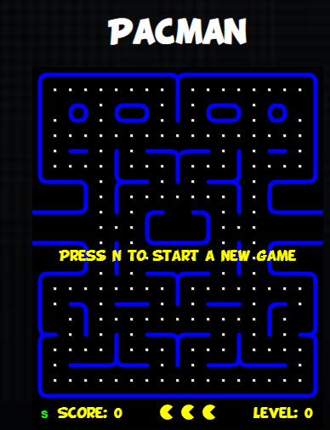
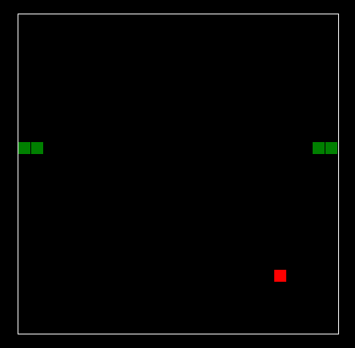

Slide 21
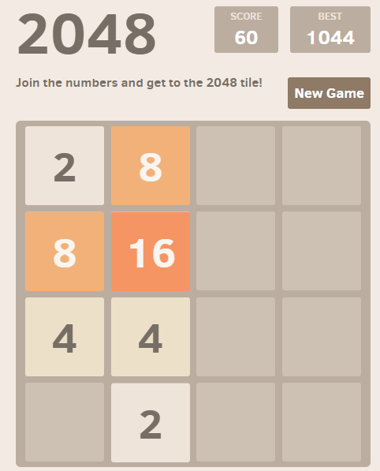
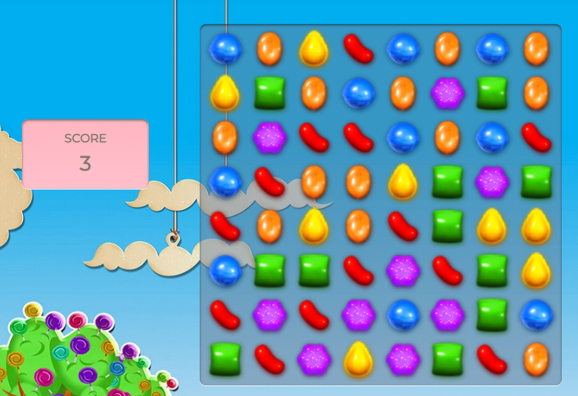

Slide 22
TESTING
Testing is executing a system in order to identify any gaps, errors, or missing requirements in contrary to the actual requirements.
We implemented our code in sublime text 3. The code is working perfectly. All the games are running perfectly with no errors.
We are running our code in Chrome browser and all the functions are working as per our requirements.

Slide 23
RESULT AND DISCUSSION
The final result is a beautiful web-page which contains icons of all the games and clicking on the icon we can change the web-page to the selected game and play it.

Slide 24
CONCLUSION
The problem was that when we face internet connectivity problem then we get only one option to pass the time until we get our internet connection back. The game that we get is a dinosaur game which is dull and we loose interest in the work which we are doing.
So we came up with and idea to solved this problem with our web games which are interesting. This way we don’t loose interest in work we are doing.

Slide 25


